Slide 1
Main title of full presentation
Please don’t add anything here

Slide 2
Acclimation of photosynthetic biochemistry to light availability

Slide 3
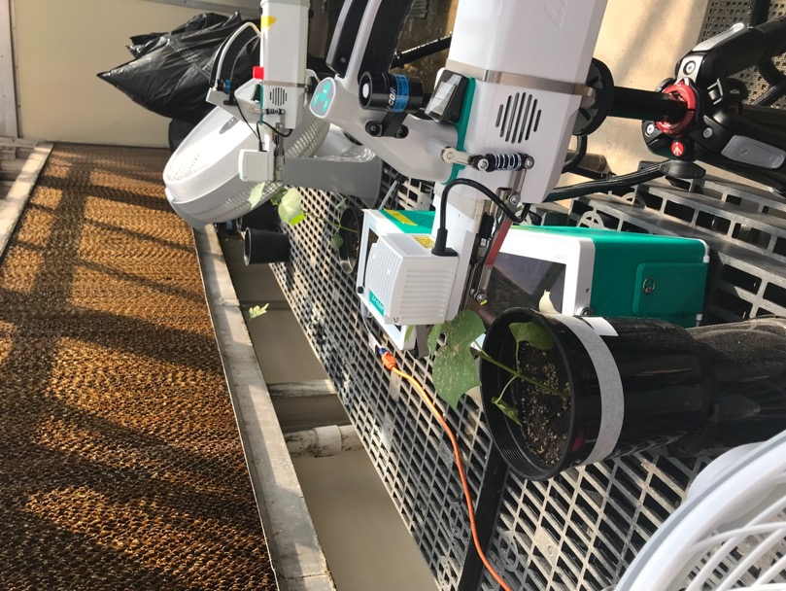
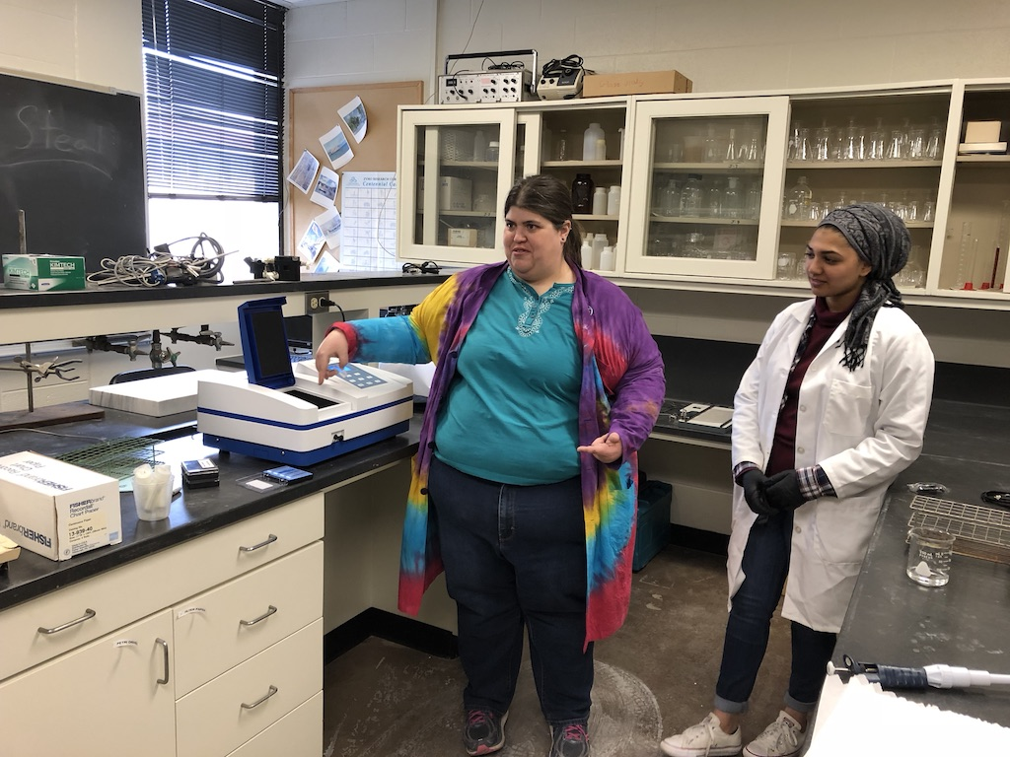
Greenhouse light manipulation experiment
Experimental setup
4 light treatments (0-80% shading)
4 soil nitrogen treatments (0-630 ppm added N)
2 species (cotton, soybean)
Measurements
A/Ci curves
Leaf chlorophyll, LMA, and N
Whole-plant C and N

Slide 4
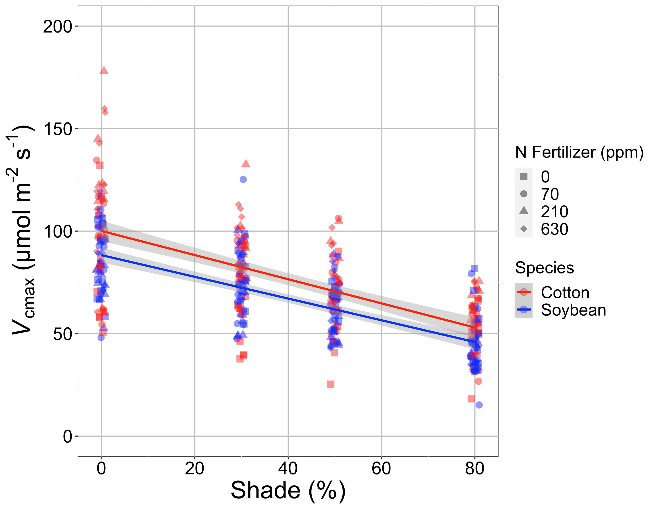
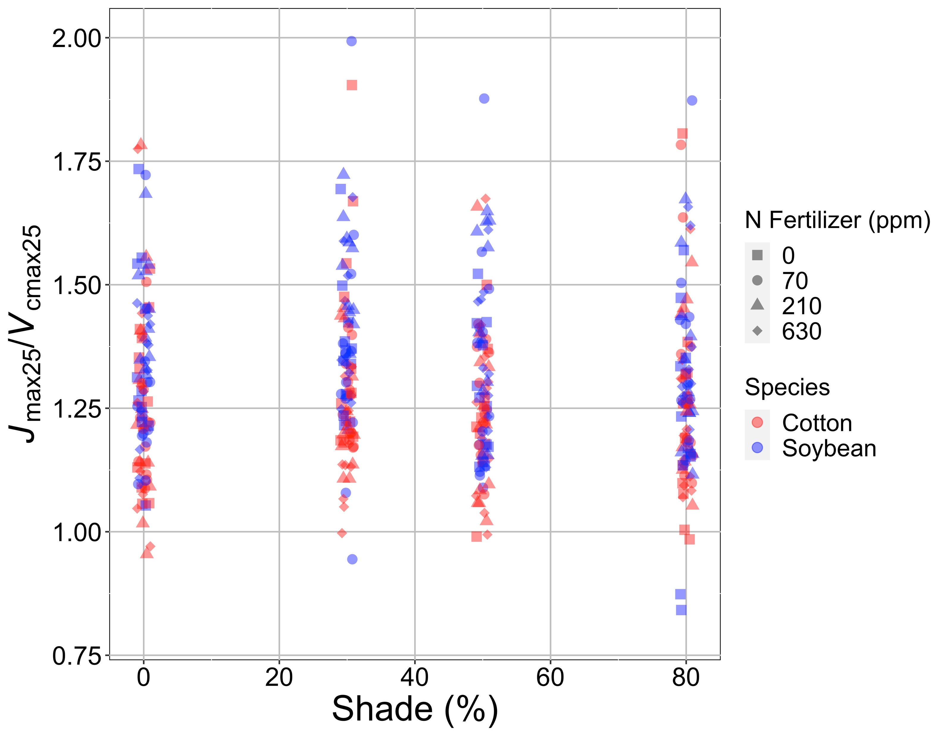
Shading reduces investment in photosynthetic biochemistry, regardless of species or N availability
Waring, Perkowski, & Smith (in review)

